Slide 1
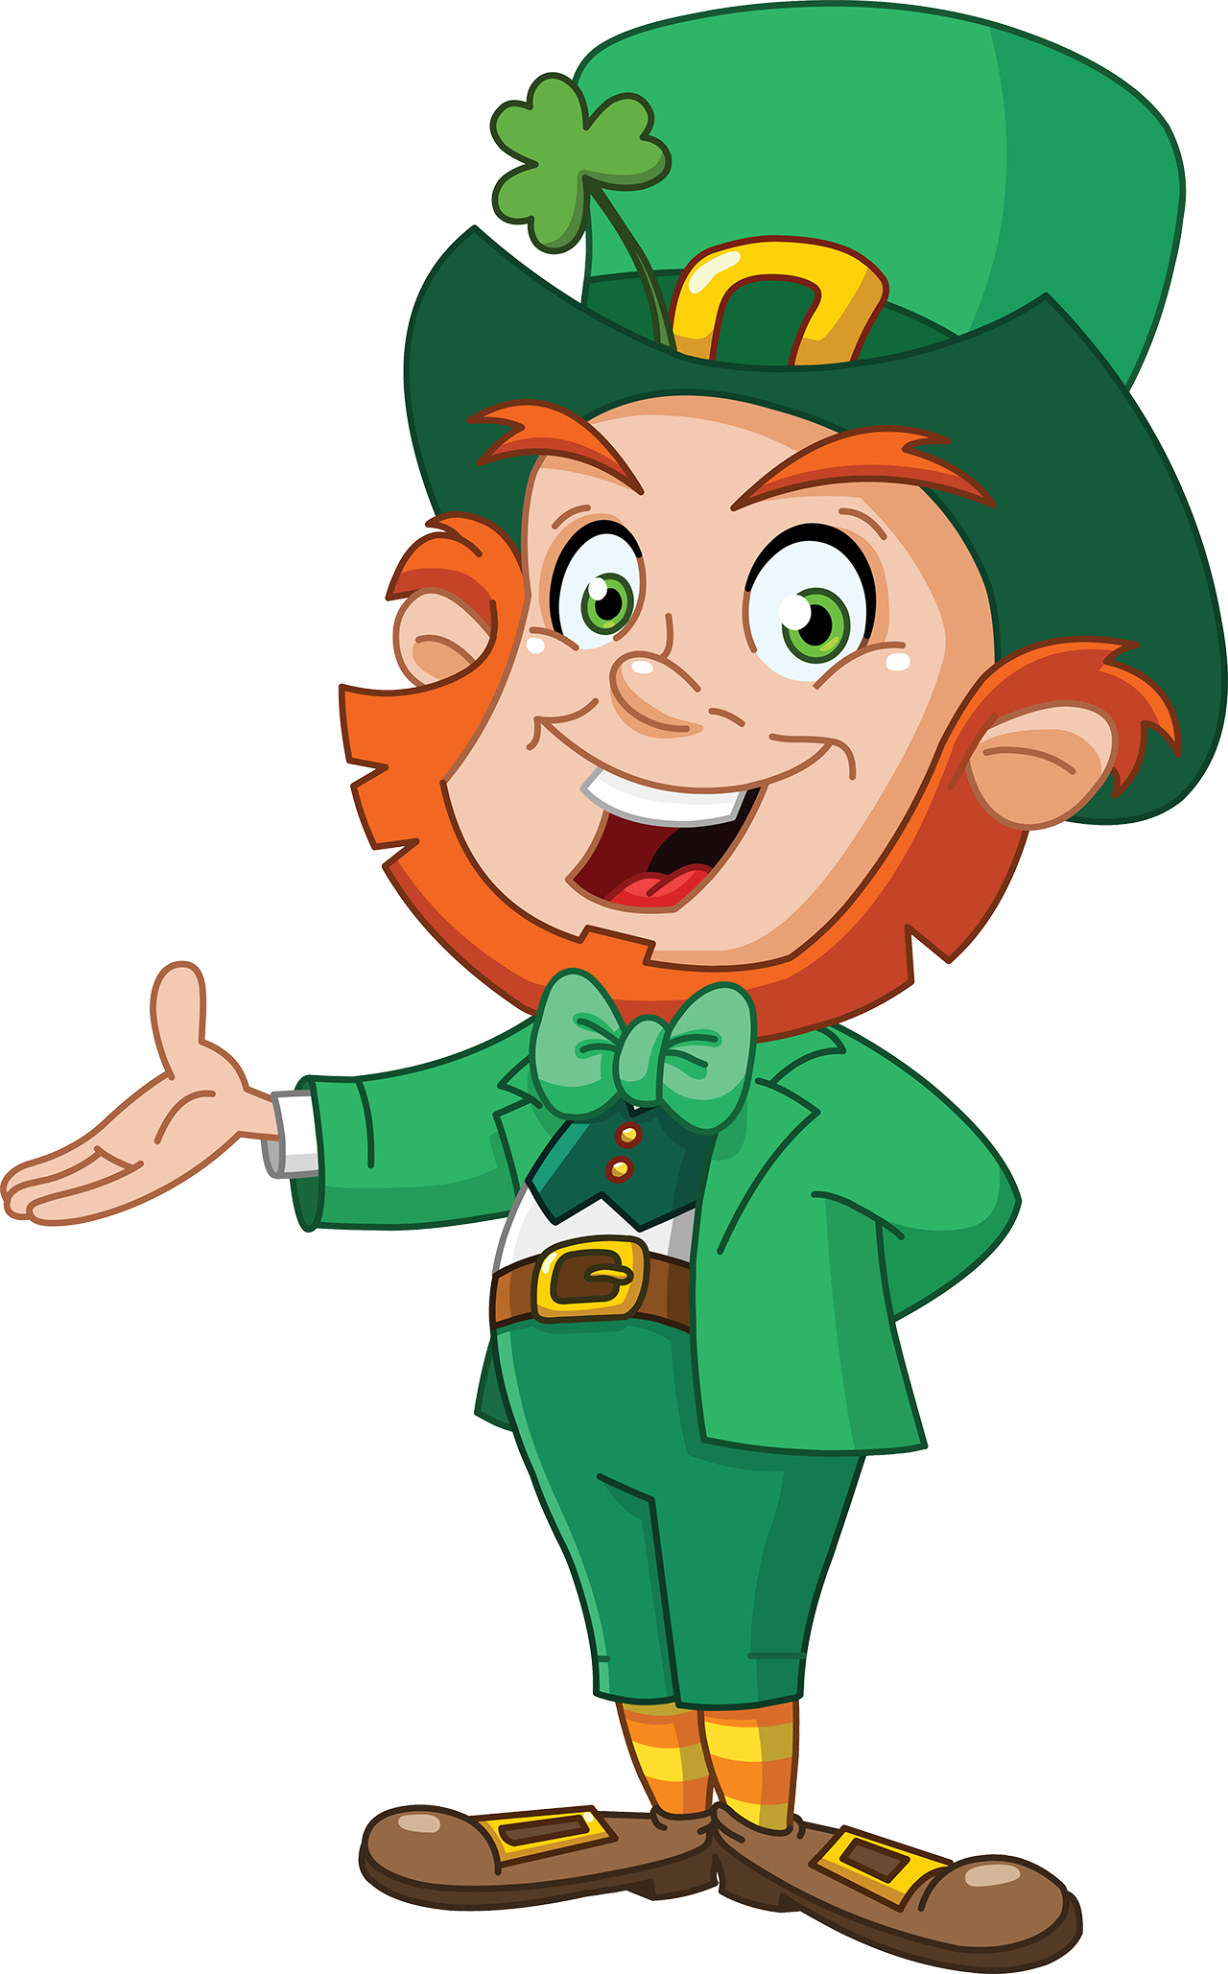
IRELAND
Let’s learn about Ireland, by Philip

Slide 2
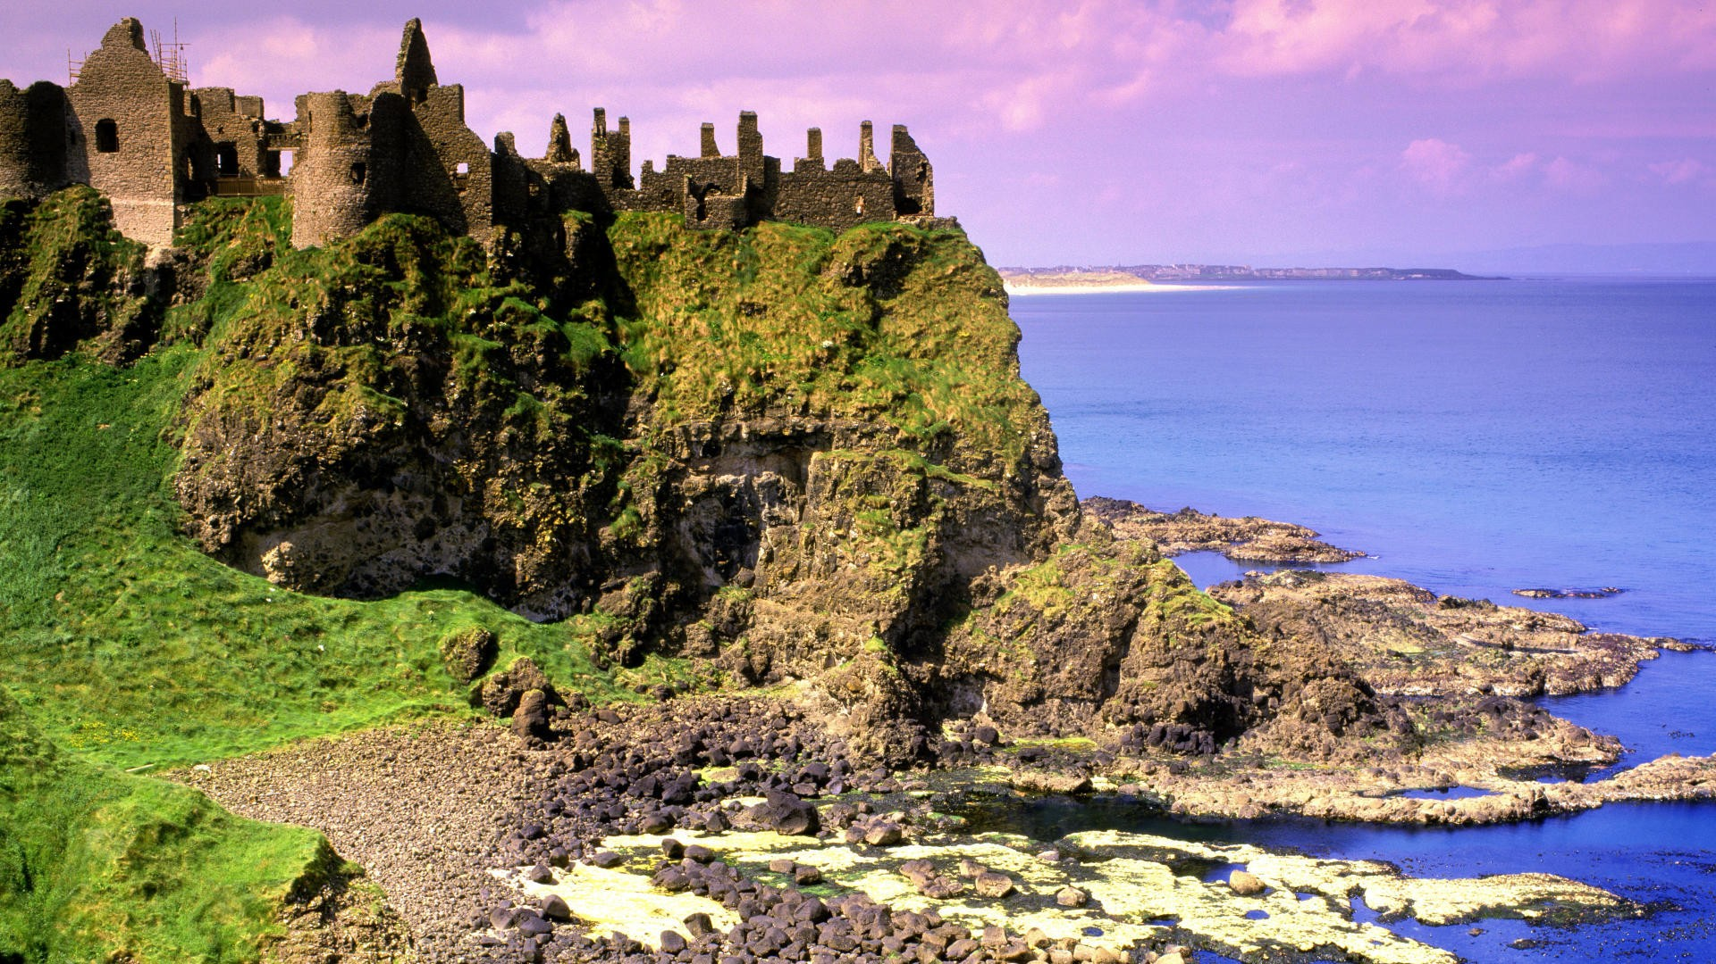

Slide 3
Let’s enjoy
a QUIZ
about
IRELAND

Slide 4
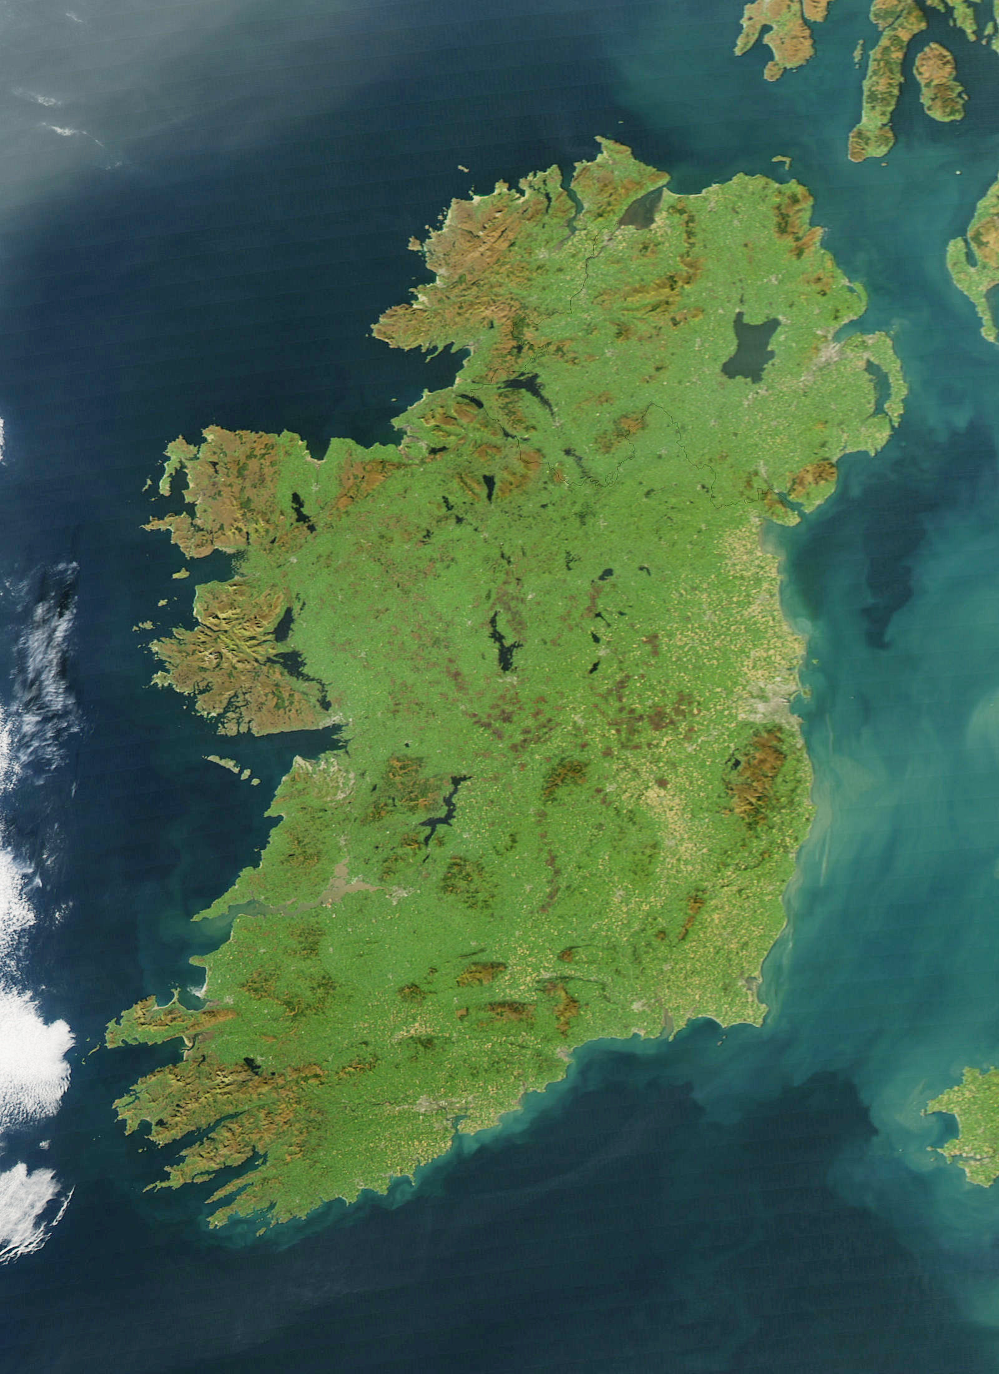

Slide 5
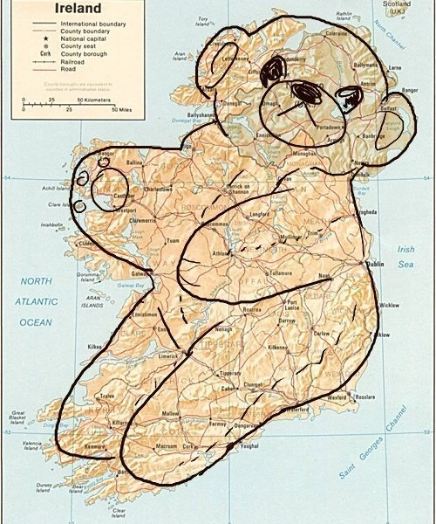

Slide 6
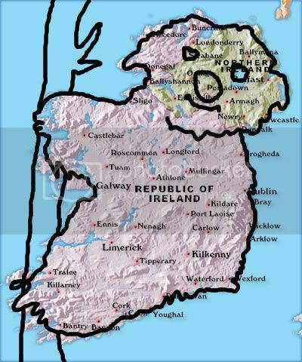

Slide 7
What is the capital of Ireland?

Slide 8
What is the capital of Ireland?
A London

Slide 9
What is the capital of Ireland?
A London
B Tokyo

Slide 10
What is the capital of Ireland?
A London
C Dublin
B Tokyo

Slide 11
What is the capital of Ireland?
A London
C Dublin
B Tokyo
D Shangri La

Slide 12
What is the capital of Ireland?
A London
C Dublin
B Tokyo
D Shangri La

Slide 13
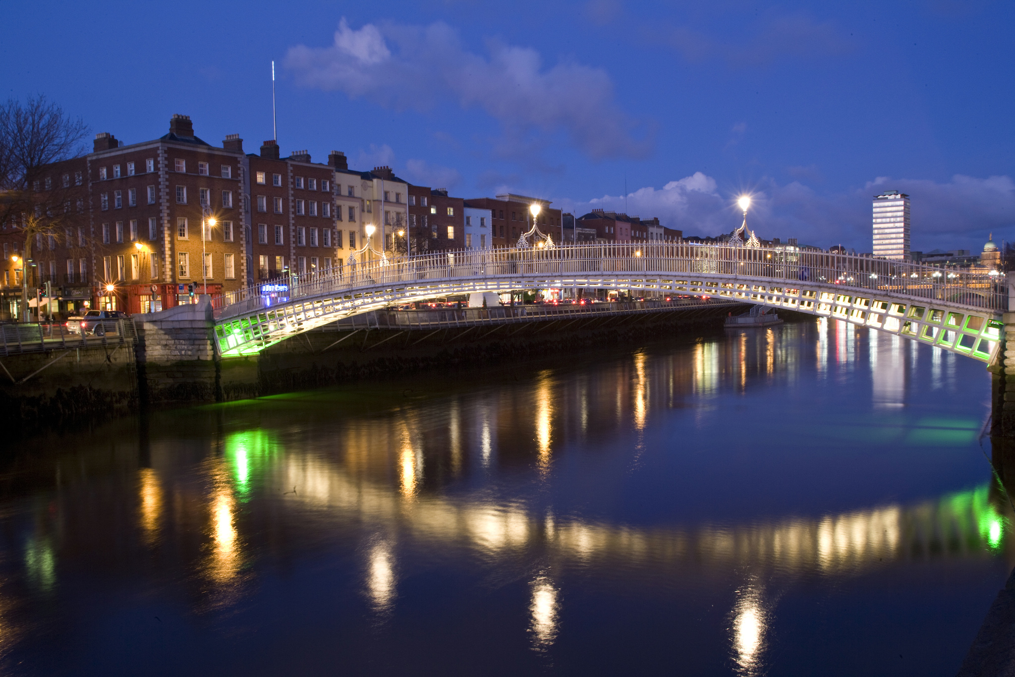

Slide 14
What musical instrument is the national symbol of Ireland?

Slide 15
What musical instrument is the national symbol of Ireland?
A Guitar

Slide 16
What musical instrument is the national symbol of Ireland?
A Guitar
B Piano

Slide 17
What musical instrument is the national symbol of Ireland?
A Guitar
C Didgeridoo
B Piano

Slide 18
What musical instrument is the national symbol of Ireland?
A Guitar
C Didgeridoo
B Piano
D Harp

Slide 19
What musical instrument is the national symbol of Ireland?
A Guitar
C Didgeridoo
B Piano
D Harp

Slide 20
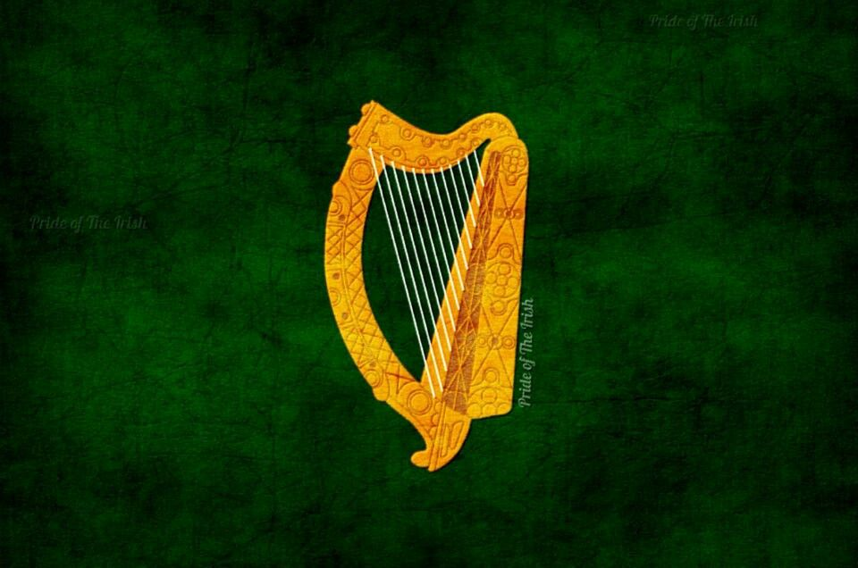

Slide 21
Which of these flags is the flag of Ireland?

Slide 22
Which of these flags is the flag of Ireland?
A

Slide 23
Which of these flags is the flag of Ireland?
A
B

Slide 24
Which of these flags is the flag of Ireland?
A
C
B

Slide 25
Which of these flags is the flag of Ireland?
A
C
B
D

Slide 26
Which of these flags is the flag of Ireland?
A Cote d‘Ivoire
C Italy
B Japan
D Ireland

Slide 27
What is the mythological creature of Ireland?

Slide 28
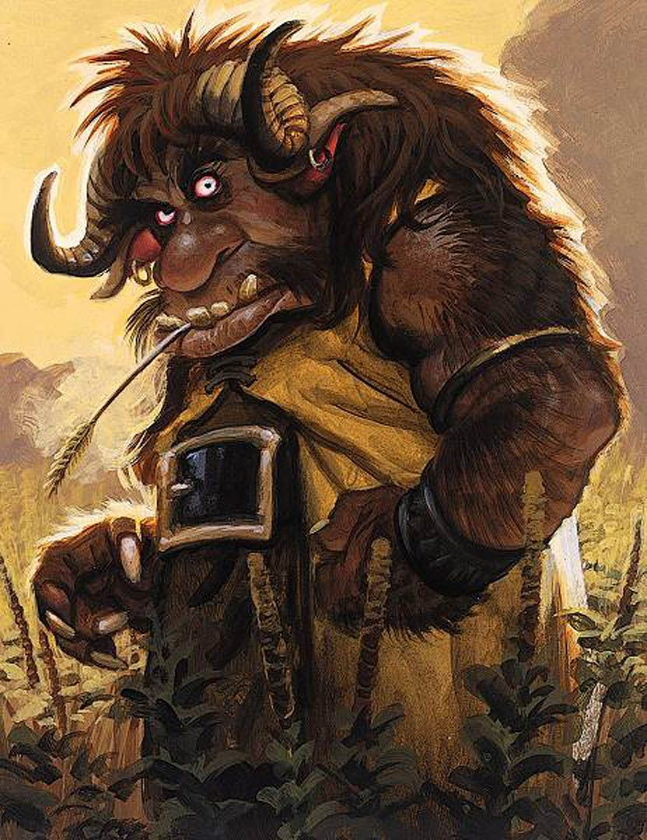
What is the mythological creature of Ireland?
A Troll

Slide 29
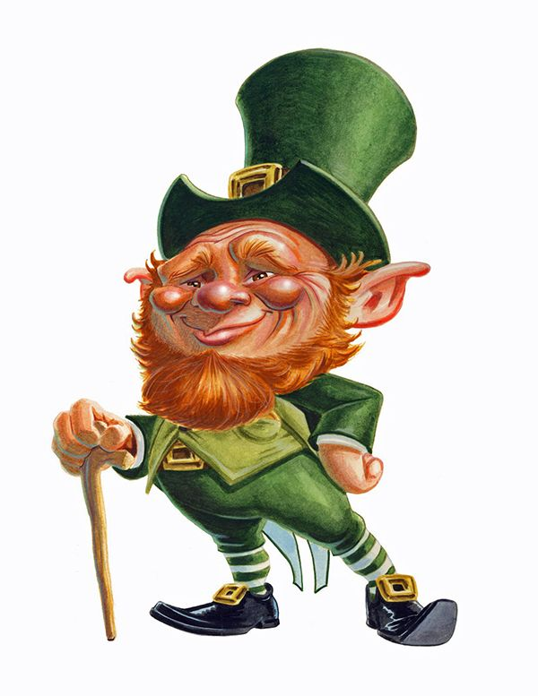
What is the mythological creature of Ireland?
A Troll
B Leprechaun

Slide 30
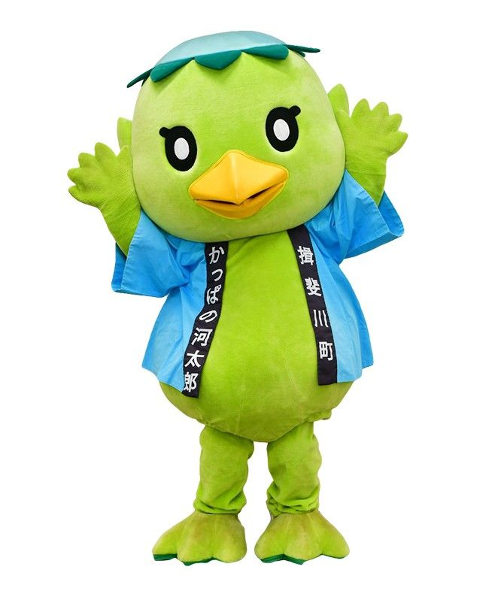
What is the mythological creature of Ireland?
A Troll
C Kappa
B Leprechaun

Slide 31
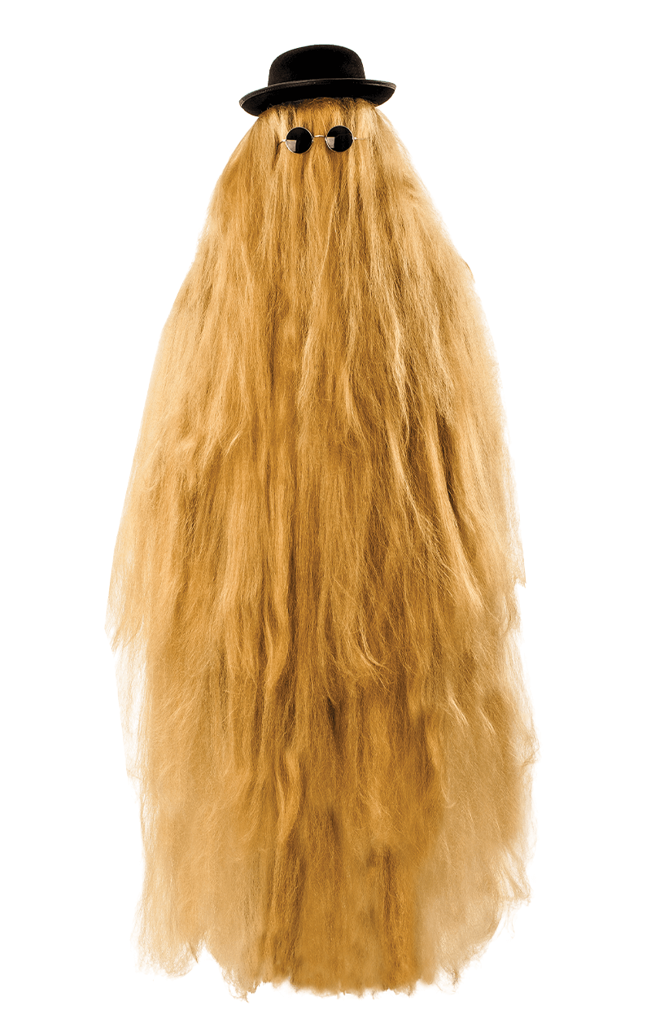
What is the mythological creature of Ireland?
A Troll
C Kappa
B Leprechaun
D Cousin Itt

Slide 32
What is the mythological creature of Ireland?
A Troll
C Kappa
B Leprechaun
D Cousin Itt

Slide 33
What does a leprechaun hide at the bottom of a rainbow?

Slide 34
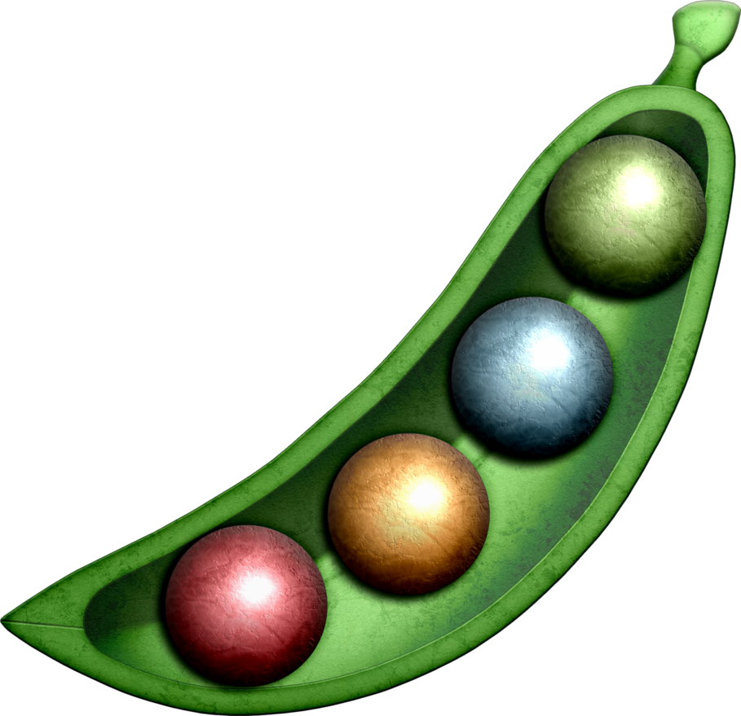
What does a leprechaun hide at the bottom of a rainbow?
A Magic beans

Slide 35
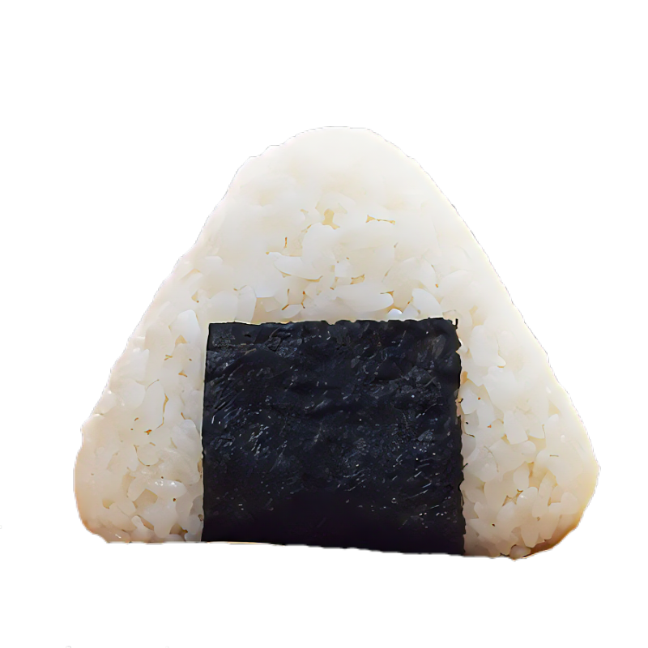
What does a leprechaun hide at the bottom of a rainbow?
A Magic beans
B A stash of
rice balls

Slide 36
What does a leprechaun hide at the bottom of a rainbow?
A Magic beans
C Green
underpants
B A stash of
rice balls

Slide 37
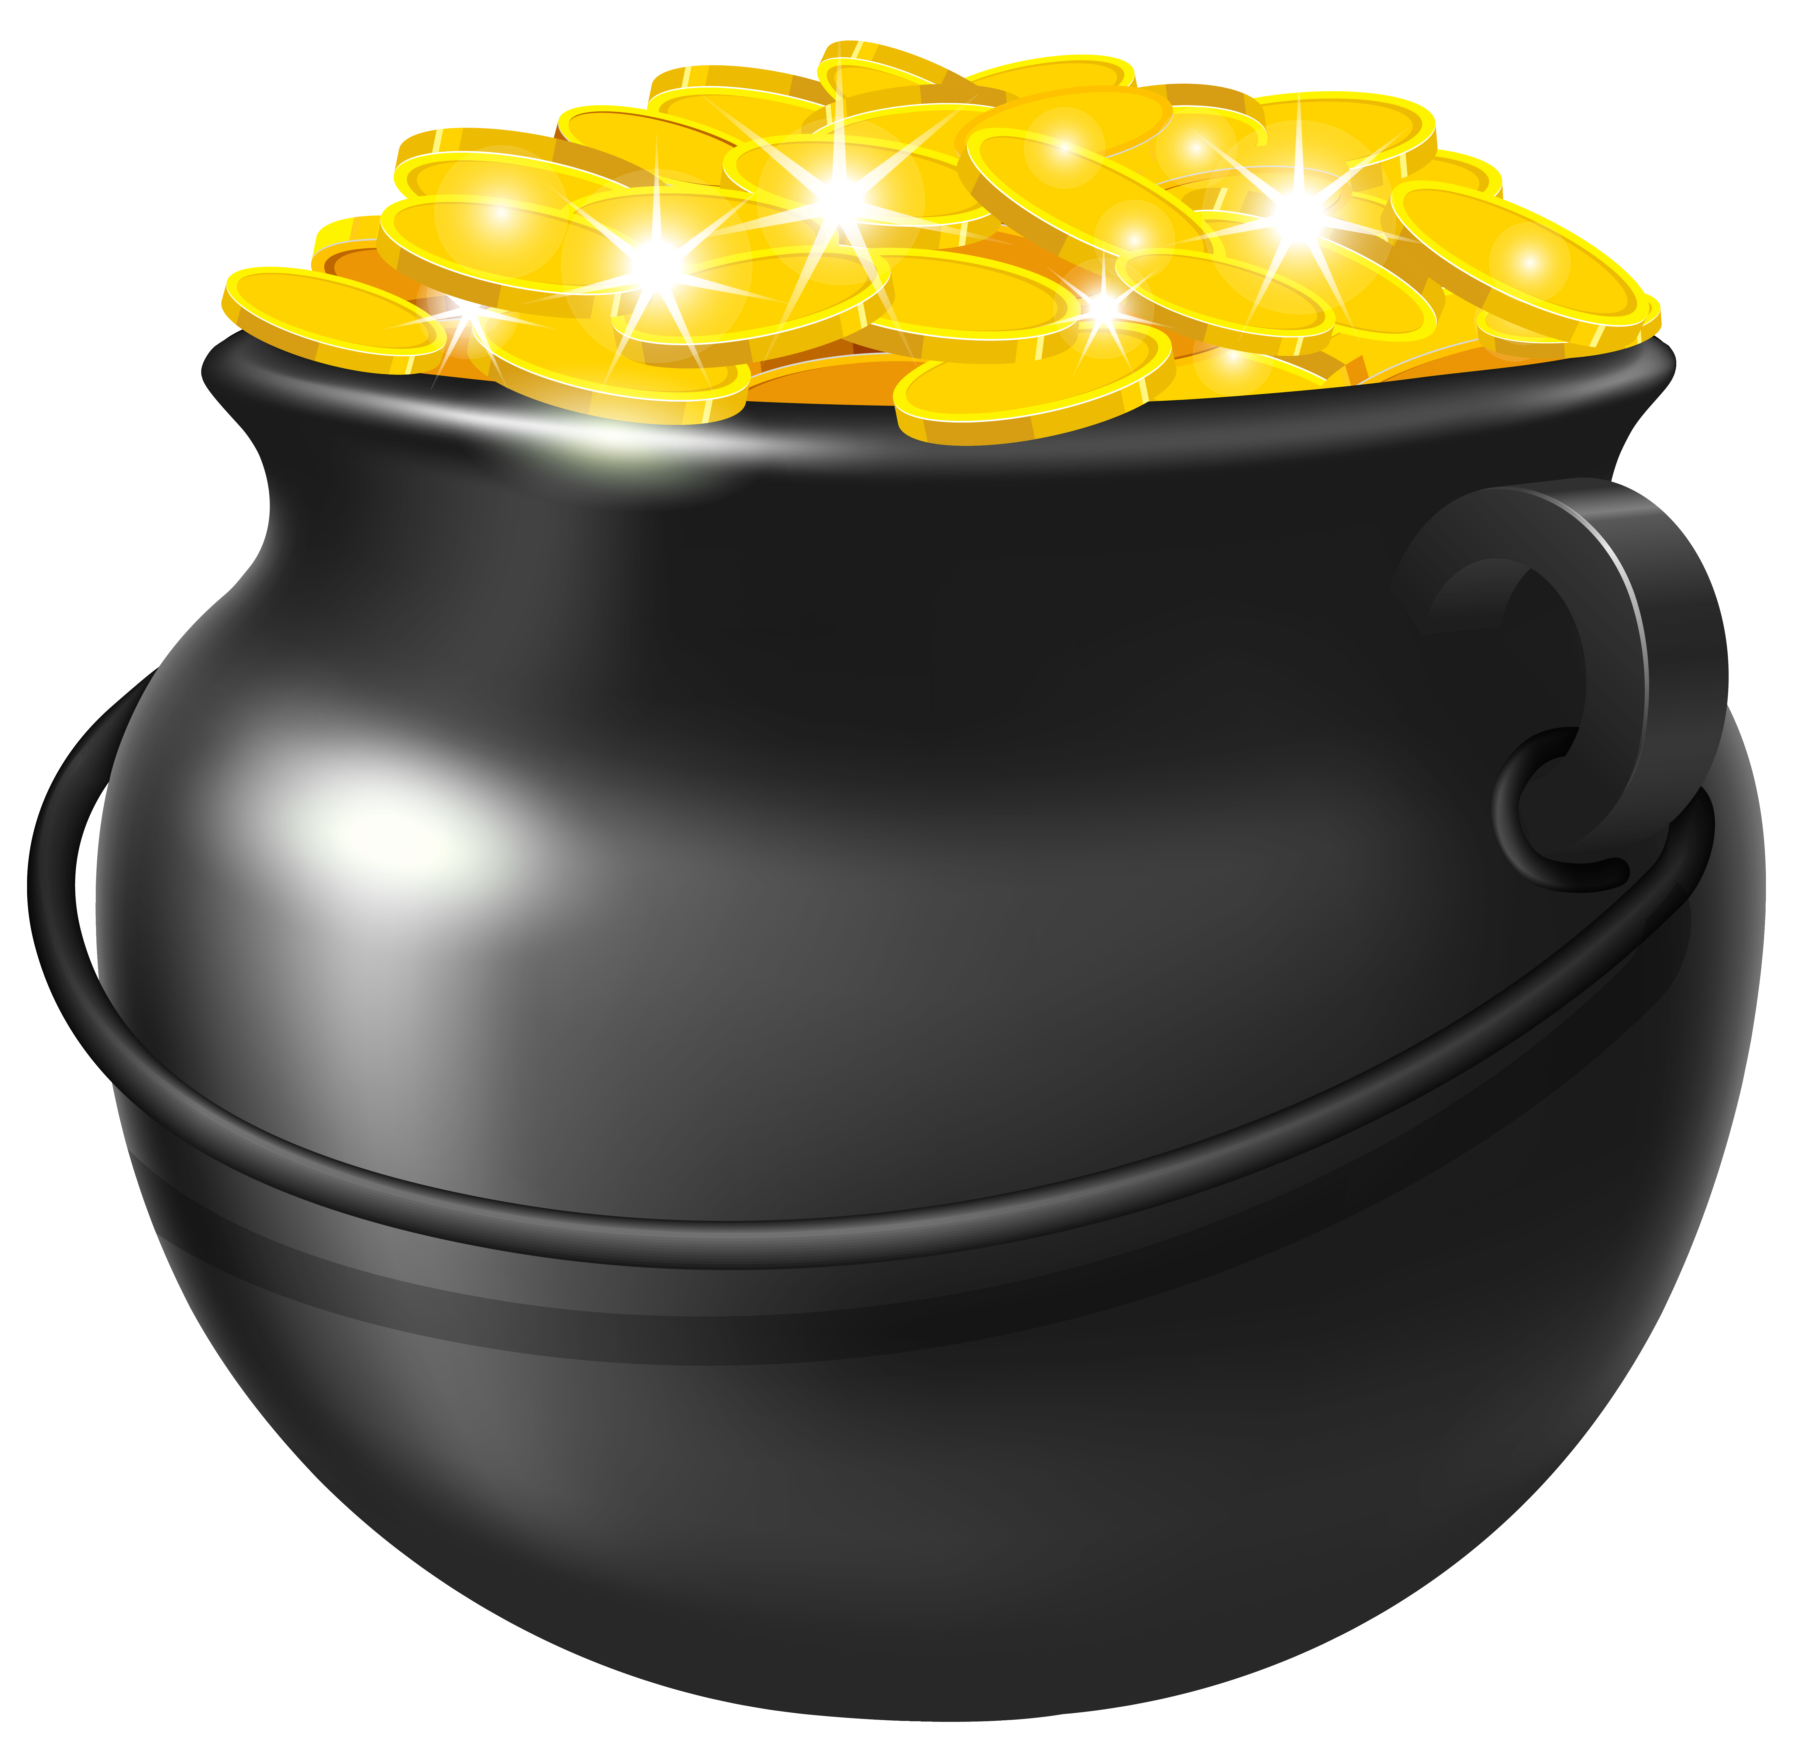
What does a leprechaun hide at the bottom of a rainbow?
A Magic beans
C Green
underpants
B A stash of
rice balls
D A pot
of gold

Slide 38
What does a leprechaun hide at the bottom of a rainbow?
A Magic beans
C Green
underpants
B A stash of
rice balls
D A pot
of gold

Slide 39
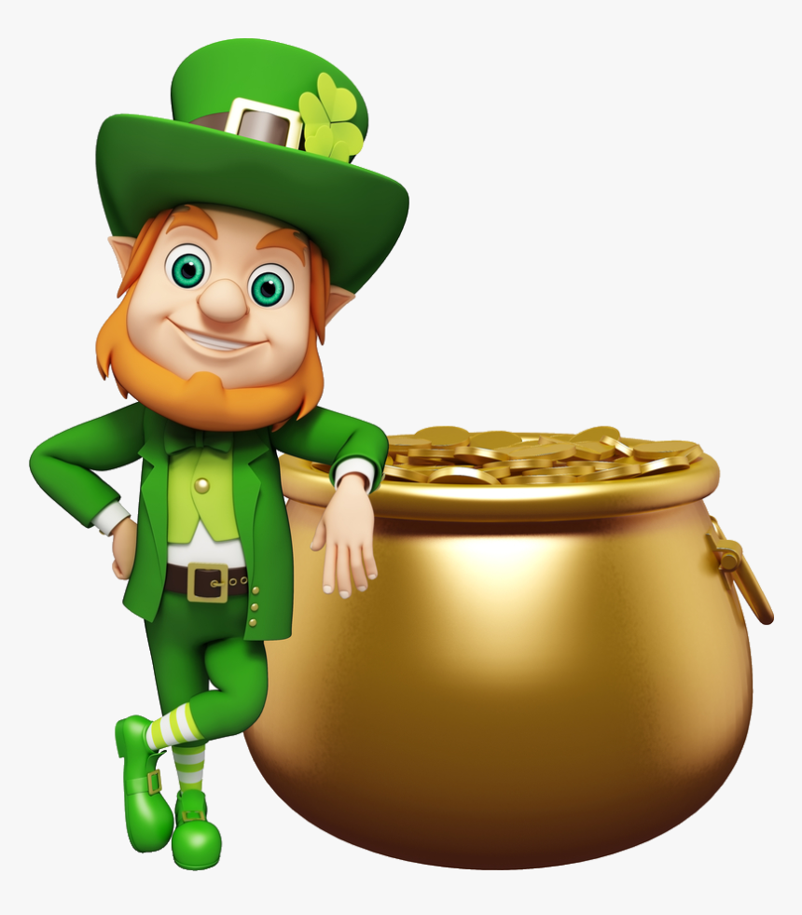

Slide 40
Which Frontierkids Global School teacher comes from Ireland?

Slide 41
Which Frontierkids Global School teacher comes from Ireland?
A Philip

Slide 42
Which Frontierkids Global School teacher comes from Ireland?
A Philip
B Fathima

Slide 43
Which Frontierkids Global School teacher comes from Ireland?
A Philip
C Mihaly
B Fathima

Slide 44
Which Frontierkids Global School teacher comes from Ireland?
A Philip
C Mihaly
B Fathima
D Daisy

Slide 45
Which Frontierkids Global School teacher comes from Ireland?
A Daisy
C Fathima
B Mihaly
D Philip

Slide 46
Which Frontierkids Global School teacher comes from Ireland?
A Fathima
C Philip
B Daisy
D Mihaly

Slide 47
Which Frontierkids Global School teacher comes from Ireland?
A Mihaly
C Mihaly
B Mihaly
D Mihaly

Slide 49
Thank you for taking part in the quiz! YOU WIN!!!

